Slide 1
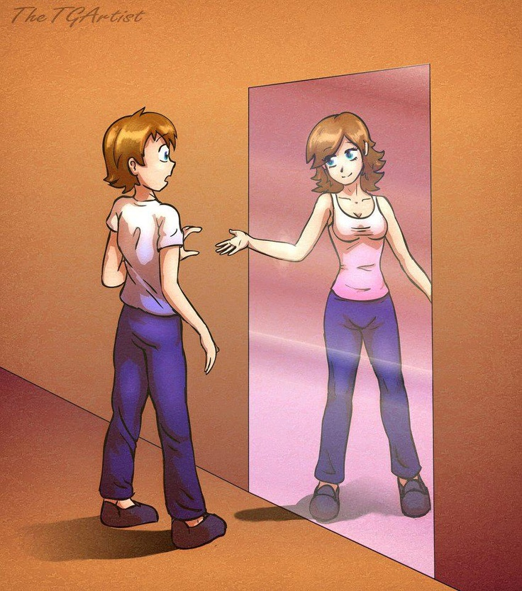

Slide 2
Transgender Adolescents
NMCSD Psychiatry Grand rounds
March 13, 2016
Tom DeBlois, M.D.

Slide 3
Definitions
Sex – anatomically male (testes) or female (ovaries)
Gender – what the person feels like internally, their sense of self as male or female or fluid (sense fluctuates/development?)
Primary sex characteristics – reproductive features such as testes, ovaries, external genitalia
Secondary sex characteristics – non-reproductive features such as breasts, facial hair, Adam's apple, pubic hair, muscle mass, pelvic/hip structure
NFTM – Natal Female to Transgender MALE
NMTF – Natal Male to Transgender FEMALE
Natal gender – assigned or birth gender
Cisgender – internal gender identity congruent w/ birth sex / sex & gender match (majority – thus why sex and gender terms are interchanged)
Transgender – internal gender identity/experience NOT congruent w/ birth sex
Gender fluid – internal gender identity/experience fluctuates & may desire he/she/they pronouns.

Slide 4
Interview PEARLS – Basic approach
Mantra …. “AFFIRM”
Listen – Show an interest in their life story and human development
Observe & analyze distress (“dysphoria”)
Be Affirming (like we should be doing with all our folks) …. State as a fact, maintain as true, offer support & encouragement and start to build rapport.
Use preferred pronouns and transgender names when given permission
Consent: Assess for soundness of judgment, insight, cognition, and emotions – general capacity to make medical and legal decisions about transition (treatment, changing name and gender on legal documents), BUT realize we are NOT assessing soundness to be transgender which is not a choice…It just is… AND we are not completing a technical legal forensic evaluation for competency.
Be Humble! Offer an apology for future misspoken errors in name, pronouns, or in general understanding of being transgender.
Know your own countertransference and address it accordingly.
Notes:
Affirm - Like we should be doing with all the folks we see

Slide 5
Dysphoria (1/3)
Dysphoric Spectrum – None to Debilitating
Dysphoric Roots: DSM – roots dysphoria from the individual’s view of their Natal gender; Clinically, dysphoria root is often related to family’s/Society’s negative view of their Transgender state)
Protective Factors: Accepting & supportive family, friends and colleagues, access to medical care to transition
Complicating Factors: Rejection from family/employer, drugs & alcohol, depression & other mental or physical health problems, suicidal/self harm thinking

Slide 6
Dysphoria (2/3)
Dysphoria Time line (History) - Childhood, Adolescents, Young Adulthood, Older Adults
Realize many have already been out as transgender for years in their “outside the military lives,” so dysphoria may have already been addressed fully or to a certain extent
*If you Feel Real & Supported > There’s Less Dysphoria
Assess for safety as this is a very high risk population for suicide

Slide 7
DSM-V (302.6) Gender Dysphoria in Children
Marked incongruence between experienced/expressed gender (Trans- ) and assigned gender (Natal-), for at least 6 months, & manifested by 6 of the following:
1. Strong Desire to be or an Insistence that One Is the Other Gender
2. Strong preference to wearing clothing of other gender and strong resistance to wearing clothing of assigned gender (Natal)
3. Strong preference for cross-gender roles in play or fantasy
4. Strong preference for toys/games/activities stereotypical of other gender
5. Strong preference for playmates of the other gender.
6. Boys: strong rejection of typically masculine toys/games/activities & avoidance of rough-&-tumble play. Girls: strong rejection of typically feminine toys/games/activities
7. Strong dislike of one’s sexual anatomy
8. Strong desire for primary and/or secondary sex characteristics that match the experienced gender (Trans-)

Slide 8
DSM-V (302.85) Gender Dysphoria in Adolescents & Adults
Marked incongruence between experienced/expressed gender (Trans- ) and assigned gender (Natal-), for at least 6 months and manifested by 2 of the following:
1. Marked incongruence between experienced/expressed gender and primary &/or secondary sex characteristics (or in teens, anticipated secondary sex characteristics).
2. Strong desire to be rid of one’s primary &/or secondary sex characteristics due to the marked incongruence with the experienced/expressed gender (or in teens, desire to prevent anticipated secondary sex characteristics).
3. Strong desire for primary and/or secondary sex characteristics of the other gender.
4. Strong desire to be of the Other Gender
5. Strong desire to be treated as the other gender
6. Strong conviction that one has the typical feelings & reactions of the other gender

Slide 9
DSM-V Gender Dysphoria Continued
Associated with clinically significant distress or impairment in social, school, occupational or other important areas of functioning
C. Specify: With a disorder of sex development (congenital adrenogenital disorder – Congenital Adrenal Hyperplasia or Androgen Insensitivity Syndrome)

Slide 10
The Evaluation Focus
General Mental Health Evaluation
- Psychiatric & Medical Hx
- “Out,” “In,” or otherwise
- Friends and Family > supportive-tolerant-ambivalent-rejecting
- Drugs and ETOH !
- Safety assessment ! > High risk: Rejection and A & D
Detailed Component (to make the diagnosis for transition)
- HP
- Developmental Hx
- Psychosocial Background
Disposition and Treatment Planning

Slide 11
Detailed Component of Evaluation (1/3)
HPI = HP HISTORY OF PRESENTATION
Transition meaning– psychological, legal, hormones, top surgery, bottom surgery
Real Life Experince (RLE) – how long living as other sex, socially/family, name, out, support network, who knows
Dysphoria - high/low, root cause, +/- managed thru counseling/social supports

Slide 12
Detailed Component (2/3)
Psychosocial Background – Family & Society Influence Gender Development
Family Structure & Belief System
Religion
Race, Socioeconomic status
School & Groups (teachers, peers, band, team sport, theatre club)

Slide 13
Detailed component (3/3)
Developmental Hx - Gender Development Focus
- First knew sex or thought something different about self
- Early View of primary sex characteristic – Penis / Vagina
- Latency Age – play, attire, behaviors, family/school/friend responses/Rxn’s
- Puberty – first menses, first wet dream, breast/body hair/ voice development hurdles if puberty not inhibited > How was this period?
- Adolescence - more secondary sex characteristic development, social, clubs/sports/drama, Kicked out, D’s & A, Suicide, Harassed/Bullied/Assaulted/ LGBT Connection
- Come out to whom? when?– As Gay? Lesbian? Transgender?

